Slide 1
Crawling towards Eternity:
Building An Archive of The World Wide Web





Slide 2
Contents








Slide 3
Introduction

  
  
  

Slide 4
Designing the Archive Crawler (1/4)
“”
  
  
  
  
  

Slide 5
Designing the Archive Crawler (2/4)

  
  
  “”

  
  
  

Slide 6
Designing the Archive Crawler (3/4)

  “”
  
  “”
  “”

Slide 7
Designing the Archive Crawler (4/4)

  
  
  

Slide 8
Robots Exclusion

  

  

Slide 9
The Robots Exclusion Protocol (1/3)

  User-agentDisallow
User-agent
  
Disallow
  
  
    Disallow: /help/help.html
    /help/index.html
    Disallow: /help//help/index.html
    /help.html

Slide 10
The Robots Exclusion Protocol (2/3)

  /cyberworld/map//tmp//fool.html
    User-agent: *
    Disallow: /cyberworld/map/
    Disallow: /tmp/
    Disallow: /foo.html

Slide 11
The Robots Exclusion Protocol (3/3)

  /cyberworld/map/cybermapper
  
    User-agent: *
    Disallow: /cyberworld/map/
    User-agent: cybermapper
    Disallow:
    User-agent: *
    Disallow:

Slide 12
The Robots META tag

  INDEX
  FOLLOW
  ALLNONE
    <META NAME=“ROBOTS”
    CONTENT=“ALL | NONE | [NO]INDEX |
    [NO]FOLLOW”>

Slide 13
How Crawler Works





  
  

Slide 14
Get new URL from
the crawl queue
Issue nonblocking “connect” to remote site
No
Error?
Yes
Poll the socket
Have you
waited too long
Ready for writing?
Issue the http GET request
No
Yes
Poll the socket
Not Ready
Have you
waited too long
Ready for reading?
Read available data
No
Done?
Yes
Process and store
the object
Figure 1. The crawling process
at Internet Archive

Slide 15
Indexing


  ’
  “”

  
  

Slide 16
The URL Problem (1/2)

  

  
  

Slide 17
The URL Problem (2/2)
’
  
  
  
  “”
H₁(URL₁) H₂(URL₁) H₃(URL₁) H₄(URL₁)
H₁(URL₂) H₂(URL₂) H₃(URL₂) H₄(URL₂)
H₁(URL₃) H₂(URL₃) H₃(URL₃) H₄(URL₃)
0 | 1 | 2 | 3 | 4 | 5 | 6 | 7 | 8 | 9 | 10 | 11 | 12 | 13 | 14
bitmap of 15 bits

Slide 18
DNS (1/5)

  
  
  

Slide 19
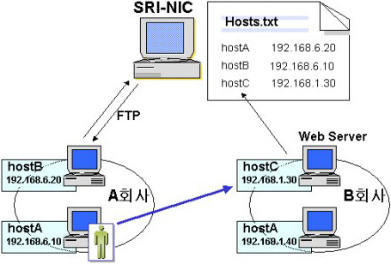
DNS (2/5)


Slide 20
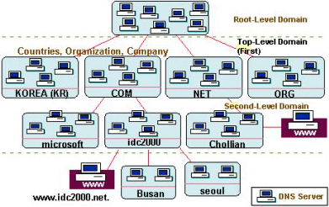
DNS (3/5)


Slide 21
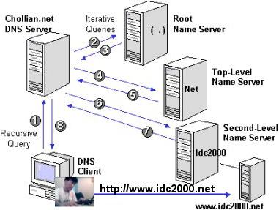
DNS (4/5)


Slide 22
DNS (5/5)

  
  
  

  
    
  
DNS
Web site
Query IP address once
Web
pages
Crawling
process
Crawl
web page
Store DNS information
DNS
map
DB

